Slide 1


CS3907/CS6444: Big Data and Analytics Summer 2021 Stephen H. Kaisler, D.Sc.
Lecture 7:
Hadoop MapReduce
&
Spark Scala

Slide 2
Data Scalability
Search Engine
10 KB / doc * 20 B docs = 200 TB
Reindex every 30 days: 200 TB/30days = 6 TB/day
Log Processing / Data Warehousing
0.5 KB/events * 3B page view events/day = 1.5 TB/day
100 M users * 5 events * 100 feeds/event * 0.2 KB/feed = 1 TB/day
Multipliers: 3 copies of data, 3-10 passes of raw data
Processing Speed (Single Machine)
2-20MB/second * 100 K seconds/day = 0.2-2 TB/day
So, 1 Machine cannot do the job!

Slide 3
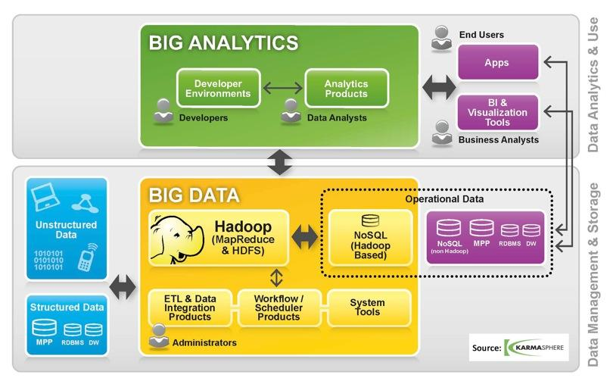
What is Hadoop?
Hadoop provides: a reliable shared storage and analysis system.
The storage is provided by HDFS and analysis by MapReduce.
There are other parts to Hadoop, but these capabilities are its kernel.
White, Tom (2010-10-01). Hadoop: The Definitive Guide: The Definitive Guide (p. 4). OReilly Media
Funded by Yahoo; created by Doug Cutting (HICSS-45 speaker)
Notes:
Hadoop is an ecosystem, e.g., a suite of different programs that interoperate to support a program development and execution environment.
It is written in Java.
It resides on top of your favorite operating system.
It can scale to thousands of processors, if need be.
It provides a file system to which subsets of the data are distributed, HDFS.
It provides two programming paradigms: MapReduce and MPI, but you can program you own processing paradigm in one of the supported languages using the MapReduce infrastructure.

Slide 4

Hadoop
Open Source Apache Project
http://hadoop.apache.org/
Written in Java
Works with other languages: c, c++, R, FORTRAN
Runs on
Linux, Windows and more
Commodity hardware with high failure rate
Based on Google’s design
Data is distributed over multiple servers, so move processing to data
Sequential processing of data set with no sharing
Notes:
We mentioned Google’s BigTable last week. Google also implemented a system for distributing processing across multiple servers.
Doug Cutting of Yahoo reverse-engineered the concepts of distributed processing into the MapReduce system, which Yahoo eventually put into open source and became part of Apache.
The basic ideas are:
Distribute the data across multiple servers
Distributes copies of the program to each server having a subset of the data
Aggregate the results when all servers are done processing data.
There is no sharing of data between servers. So, essentially, we are assuming that each data record is independent of any other data record for processing purposes.
If not, you need another processing paradigm (initially).

Slide 5
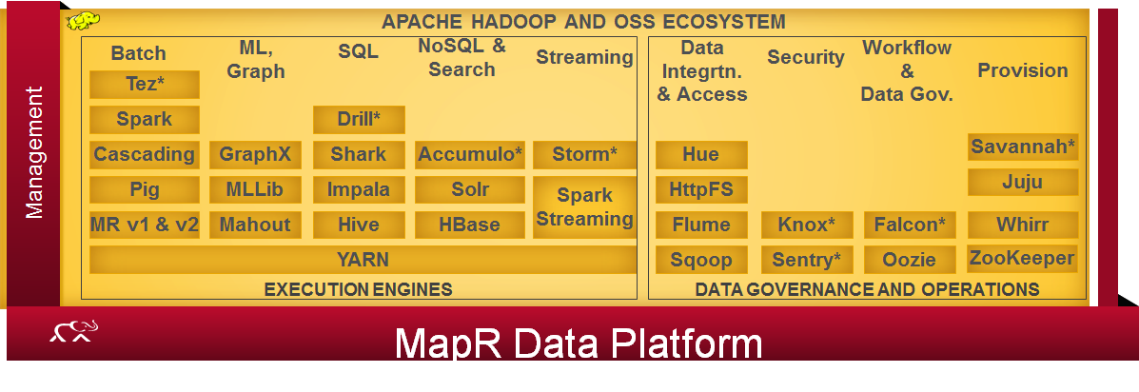
Hadoop Components
Hadoop consists of three core components:
The Hadoop Distributed File System (HDFS)
Scheduler (Yarn)
Processing modules: MapReduce or MPP
The servers running HDFS and MapReduce are known as a Hadoop Cluster
Individual machines are known as nodes
A cluster can have as few as one node, as many as several thousands
More nodes yield increased performance (depending on the algorithm)
Notes:
HDFS is installed on each of the data nodes. It holds the subset of data distributed to the data node.
MapReduce read/write functions access the HDFS.
The Scheduler handles scheduling of multiple tasks running on the data nodes.
The Processing modules are tasks that execute the application code that you have written to process the data.
The box depicts some of the components of the Hadoop ecosystem that support the other 80% of the work effort having to do with ETL and curation as well as management and administration.

Slide 6
Hadoop Cluster
Single machine cannot serve all the data: you need a distributed special (file) system
Large number of commodity hardware disks: say, 1000 disks @ 1TB each = 1 PB
Issue: With Mean time between failures (MTBF) or failure rate of 1/1000, then at least 1 of the above 1000 disks would be down at a given time.
Failure is norm and not an exception!
File system has to be fault-tolerant: replication, checksum
Data transfer bandwidth is critical (location of data)
Critical aspects: fault tolerance + replication + load balancing, monitoring
Exploit parallelism in the problem by splitting the computation across multiple processors
Provision and locate computational processes at the data locations
Notes:
Remember earlier we said data sizes are going up!
But, computational speed per processor is slowly increasing: right now about 5.2 GHz; probably topping out at 10 GHz
- Physics Rules!!
Commodity disks are very reliable, but still fail randomly.
Failure can be sudden or a slow death
At least in the latter you can detect it and back everything up.
You should back everything up anyway – on another disk or USB or, shudder, the cloud.

Slide 7
Hadoop Concepts
A Hadoop cluster consists of
A single Name Node, a master server that manages the file system namespace and regulates access to files by clients.
1 to N Data Nodes (N = a very large integer)
The Data Nodes manage storage attached to the nodes.
HDFS supports a file system namespace that allows user data to be stored in files.
A file is split into one or more blocks
Sets of blocks are stored in Data Nodes.
All blocks in the file except the last one are of the same size.
Data Node: serves read and write requests, performs block creation, deletion, and replication upon instruction from Name Node.
Best utilized for
Large scale batch analytics
Unstructured or semistructured data; Flat files
Streaming data
Notes:
Any metadata changes to the file system are recorded by the Name Node.
Name node uses a transaction log called the EditLog to record every change that occurs to the filesystem meta data.
For example, creating a new file.
Change replication factor of a file
EditLog is stored in the Name node's local filesystem
Entire filesystem namespace including mapping of blocks to files and file system properties is stored in a file FsImage. Stored in Name node's local filesystem.
The key idea is that the data node is NOT a long-term repository, but a short-term – for the duration of the MapReduce job – temporary repository.
Between MapReduce jobs by different users, you wipe the Data Nodes clean and repopulate them before running the next job.

Slide 8
Why Do We Need Something Like HDFS?
At Google, MapReduce operations are run on a special file system called the Google File System (GFS) that is highly optimized for this purpose.
But, GFS is not open source.
Doug Cutting and Yahoo! reverse engineered the GFS and called it the Hadoop Distributed File System (HDFS).
Yahoo! contributed it to the Apache Foundation
CPU & transfer speed, RAM & disk size were doubling every 18 - 24 months
Seek time nearly constant (~5%/year)
Time required to read entire drive is growing vs. transfer rate.
Moral: scalable computing must go at the data transfer rate
Implies: Scale out not Scale Up
Notes:
B. Ramamurthy, https://cse.buffalo.edu/~bina/cse421/fall2010/HDFS.ppt

Slide 9
Hadoop Distributed File System (HDFS)
Basic Idea: Separation of computation and data storage
Divide user data into blocks which are stored on data nodes
Highly tolerant of disk or node failure
Replicate those blocks across the local disks of nodes in the cluster
The number of replications of a file is configurable
Name Node keeps track of what blocks are on what data nodes
Implements a master/slave architecture:
The master maintains the file namespace (metadata, directory structure, file to block mapping, location of blocks, and access permissions).
The slaves manage the actual data blocks.
Key features:
Java-based
Files are broken into 64 MByte chunks
Sharding: the partitioning of data among multiple machines in an order-preserving manner. (horizontal scaling)
Notes:
On startup Name node enters Safemode.
Replication of data blocks do not occur in Safemode.
Each Data Node checks in with Heartbeat and BlockReport.
Name node verifies that each block has acceptable number of replicas
After a configurable percentage of safely replicated blocks check in with the Name node, Name node exits Safemode.
It then makes the list of blocks that need to be replicated.
Name node then proceeds to replicate these blocks to other Data nodes.

Slide 10
HDFS Features
Scalability: scalable to petabytes (claimed)
Ability to add and remove Data Nodes
Reliability and Fault Tolerance:
Data replicated across multiple nodes so that even if a few nodes are down, the data is available
Configurable based on parameters
Default replication factor is 3; 200% increase in storage
Data coherency:
HDFS has Write Once, Read Many (WORM) model
Hardware Failure Recovery:
Assumes some node in the cluster will fail
Implement failover processes which can recover data
Computation closer to data
Moves the computation process to the data by associating
processing nodes with data nodes
Notes:
Failover processes are built into data nodes, e.g., automatic restart some number of times.
When a data node is restarted, Name Node attempts to restart Task Trackers on the data Node.
If this fails, the data node is declared won.
Since we have replicate copies of MR tasks on multiple data nodes, we expect at least one of replicates to complete (the statistics are in our favor).
Thus, when the job is complete we expect one replicate of each tasks to have completed and therefore the job to have successfully completed.
Of the replicates, the one that completes first is the winner.

Slide 11
Name Node
The Name Node:
Maintains an image of the entire file system namespace and file Blockmap in memory.
Manages the file system namespace
Controls read/write access to files
Determines the mapping of data chunks to Data Nodes
Monitor Data Nodes by receiving heartbeats
Manages block replication
Does not store any data
Checkpoints namespace and journals namespace changes for reliability
Metadata of Name Node in Memory
The entire metadata is in main memory
No demand paging of file system metadata
The Name Node is simply a server and never initiates a request; it only responds to RPC requests issued by DataNodes or clients.
The Data Nodes talk to the Name Node using the DataNode protocol.
Notes:
Keeps image of entire file system namespace and file Blockmap in memory.
4GB of local RAM is sufficient to support the above data structures that represent the huge number of files and directories.
When the Name node starts up it gets the FsImage and Editlog from its local file system, update FsImage with EditLog information and then stores a copy of the FsImage on the filesystem as a checkpoint.
Periodic checkpointing is done. So that the system can recover back to the last checkpointed state in case of a crash.

Slide 12
Data Node
A Data Node stores data in files in its local file system.
It has no knowledge about the HDFS filesystem
It stores each block of HDFS data in a separate file.
A Data Node does not create all files in the same directory.
Heuristics are used to determine the optimal number of files per directory
Data Nodes act as:
1) A Block Server
– Stores data in the local file system
– Stores metadata of a block (e.g. CRC)
– Serves data and metadata to Clients
2) Block Report: Periodically sends a report of all existing blocks to the Name Node
3) Periodically sends heartbeat to Name Node (detect node failures)
Facilitates Pipelining of Data (to other specified Data Nodes)
Serve read/write requests from clients
Perform replication tasks upon instruction by Name Node
Notes:
When the filesystem starts up it generates a list of all HDFS blocks and send this report to Name node: Blockreport.
All HDFS communication protocols are layered on top of the TCP/IP protocol
The Data nodes talk to the Name node using Data node protocol.
RPC abstraction wraps both ClientProtocol and Data node protocol.
Name node is simply a server and never initiates a request; it only responds to RPC requests issued by Data Nodes or clients.

Slide 13
Job Processing
TaskTracker 1
TaskTracker 2
TaskTracker 0
JobTracker
TaskTracker 3
TaskTracker 4
TaskTracker 5
“grep”
Client submits “grep” job, indicating code and input files
JobTracker breaks input file into k chunks, (in this case 6). Assigns work to trackers.
After map(), tasktrackers exchange map-output to build reduce() keyspace (not shown)
JobTracker breaks reduce() keyspace into m chunks (in this case 6). Assigns work.
Reduce() output goes to HDFS
Notes:
The Job Tracker runs on the Name node.
It initiates the Task Trackers on each of the data nodes.
It breaks the input file into k chunks of size 64M bytes. So, |dssize|/64M -> k,
And k/n chunks are distributed to each data node as separate processing tasks, such that n < k, except for data node n. Why?
Task trackers keep status of each task and periodically update the Job Tracker.
Job Tracker reports back to calling program when MapReduce job is complete.

Slide 14
Job/Task Trackers
JobTracker (master)
Receive jobs from client.
Talks to the Name Node to determine the location of the data
Manage and schedule the entire job.
Split and assign tasks to slaves (Task Trackers).
Monitor the slave nodes by receiving heartbeats.
Task Trackers (slaves)
Manage individual tasks assigned by the Job Tracker, including Map operations and Reduce operations.
Every Task Tracker is configured with a set of slots, these indicate the number of tasks that it can accept.
Send out heartbeat messages to the Job Tracker to tell that it is still alive.
Notify the Job Tracker when succeeds or fails.

Slide 15
What is MapReduce?
MapReduce is:
A programming paradigm that allows for massive scalability from one or two to hundreds or thousands of servers in a Hadoop cluster
Fairly simple to understand
Easy parallel programming
Simple programming model:
All data can be mapped into <key, value> pairs
Keys and values may be of any type: strings, integers, dummy types... and, of course, <key,value> pairs themselves
Five Simple concepts (Lammel 2007)
(i) iteration over the input
(ii) computation of key/value pairs from each piece of input
(iii) grouping of all intermediate values by key
(iv) iteration over the resulting groups
(v) reduction of each group
Notes:
Parallel processing is still an art, not quite a science
No general purpose algorithm for generating parallel programs
But, there are well-known models for constructing parallel programs
Much optimization at the supercomputer and parallel processor level
Automatic parallelization of FORTRAN programs since the Cray-1
Kaisler dissertation: Making Concurrency Explicit: Converting Object-Oriented to Process-Oriented Programs showed how to automate parallelization under certain constraints.

Slide 16
Why MapReduce?
To harness the power of big data:
we require an infrastructure that can manage and process huge volumes of structured and unstructured data in real-time and can protect data privacy and security.
To process large volumes of data (petabytes to exabytes), we need to use massively parallel processors that may have to touch most or all of the data.
Cannot scale due to physical limitations, so we must scale out.
This means distributed processing across large clusters from 2 to 100,000 processors (or more).
Scalable: Scalability is the ability of an IT system to expand to meet your business needs (as your business grows).
Either add more hardware or upgrade the hardware.
Note: By processors, we mean both physical microprocessors as well as multi-core processors.
Notes:
We addressed the question of how we store big data to a certain extent in the last lecture.
Now, we will address the question of how we process it.
Clearly, even with 256G bytes of memory we will be hard pressed to process several terabytes of data in a reasonable time. Why?
We need to stage chunks of data into and results out of memory. Remember that disks are up to 1,000 times slower than memory.
If we have to randomly access data across terabytes, we have real problems about how to swap subsets of data in and out of memory.
You probably want to disable cache (see CSCI 6461)

Slide 17
MapReduce Scope
Data size: small
Single-core
Single-core, single processor
Single-core, multi-processor
Multi-core
Multi-core, single processor
Multi-core, multi-processor
Cluster
Cluster of processors (single or multi-core) with shared memory
Cluster of processors with distributed memory
Grid of clusters
Embarrassingly parallel processing
MapReduce, distributed file system
Cloud computing
Pipelined Instruction level
Concurrent Thread level
Service Object level
Indexed File level
Mega Block level
Virtual System Level
Data size: large
Source: B.Ramamurthy & K.Madurai, CCSCNE 2009

Slide 18
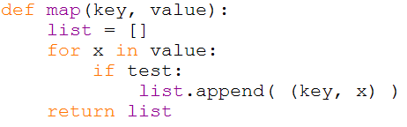
The Map Function
A primitive of many functional programming languages (FPLs), e.g., Common Lisp
Operators in FPLs do not modify the structure of the original data; rather, they create new data structures as their output
Map:
Applies a function to a set or list of elements; produces a new list
Ex: summing numbers in a list; filtering out values according to some criterion; counting # elements of a given type
For Big Data sets (e.g., TBytes or PBytes), split data set evenly across multiple processors and let each perform the map function
Notes:
Many languages now have a mapping function built-in or defined in a library.
Built-in definitions are very useful because their implementation is usually optimized in the language compiler.
Think of the Java Iterator’s

Slide 19
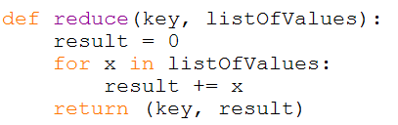
The Reduce Function
Also a primitive of FPLs for many years
Takes the output of a map function and “reduces” the list or set according to some criteria
Taking a sorted list of numbers and counting the number of numbers in each decade or hundred
Distribute the map outputs across multiple processors and apply reduce to each set
Repeat as necessary, based on criteria
Notes:
Another iteration function.
Reduce can be used in many ways on the resulting data sets by key:
To sum, average, compute differences, etc. for asset of values assembled at a node
To generate new labels, perhaps a more compact group, for the values in the dataset
Translate the values to a new form based on the distribution of values or other criteria in the data set

Slide 20
Basic MapReduce Concepts
Applications are written in high-level code
Developers don’t have to worry about network programming, temporal dependencies, etc.
Data is spread among machines in advance
Computation happens where the data is stored, wherever possible
Data is replicated multiple times on the system for increased availability and reliability
Concept of Data Sharding – “Shared Nothing”
Decompose input data into smaller chunks called “shards”
Spread them across a number of distributed servers.
Advantages and Disadvantages:
Difficult to write shard’ing code
Hadoop data breaks across arbitrary boundaries
No interaction among shards
Nodes talk to each other as little as possible
Developers should not write code which communicates between nodes
Notes:
Support for several programming languages: R, FORTRAN, C/C++, Java.
If you can write a Java wrapper for a language, you can probably use that language.
Distribute the data in advance. You get to choose the number of data nodes, subject to physical node availability and organization policies.
Hadoop divvies up the data set into chunks.
The problem is that Hadoop will break across arbitrary boundaries, so one shard may end in the middle of a record.
You need to think about padding.
With MapReduce, little or no interaction among data nodes. So, makes certain algorithms difficult to implement. 2D FFTs come to mind, although I was told that someone finessed an implementation in MapReduce.

Slide 21
Why Do Local Aggregation?
Ideal scaling characteristics:
Axiom: Twice the data, (at least) twice the running time
Axiom: Twice the resources, (at most) half the running time
Why can’t we achieve this?
Synchronization requires communication
Communication kills performance
Thus… avoid communication!
Reduce intermediate data via local aggregation
Combiners can help
Notes:
Most distributed applications require some communication among the distributed tasks.
And, most distributed tasks have to be synchronized to achieve the overall objective.
Communication is slow over interprocessor networks, usually due to software layers.
Thus, MapReduce is a subset of the more general parallel processing algorithms. By avoiding communication and a few other restrictions on MapReduce jobs, computation can go very fast – but is limited by disk I/O.
If you can load everything into memory, it goes at nearly memory speed.

Slide 22
MapReduce Programming Model
Determine if the problem is parallelizable and solvable using MapReduce.
Design and implement solution as Mapper classes and a Reducer class.
Compile the source code with Hadoop core.
Package the code as a jar executable.
Configure the application (job) as to the number of mappers and reducers (tasks), input and output streams
Load the data (or use it on previously available data)
Launch the job and monitor.
Study the result.
Notes:
Pretty straightforward…
Where doe the magic occur?
In writing simple mappers and reducers. The more complex the mappers and reducer, the greater impact on computing on key-value pairs.
You need to consider the size of the original data set and how it will be divided among the number of data nodes allocated to you.
The diversity of the data and distribution of keys can also have an effect on how long it takes each data node to complete its task.

Slide 23
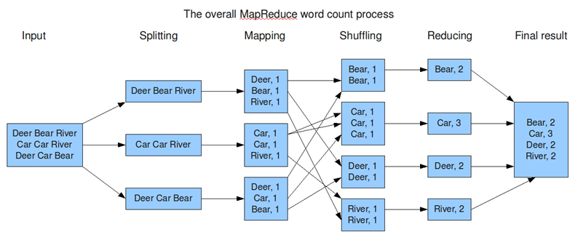
MapReduce Basics
Based on acyclic data flow from stable storage to stable storage
Runtime can decide where to run tasks and automatically recover from failures.
“Moving computations is cheaper than moving data.”
Notes:
Student Exercise:
Given 4 data nodes and a 256G byte data set and a local network running at 100M bits/second.
How many shards do you need to move to each data node?
How long does it take to move the data from the host processor to each of the data nodes? (assume negligible time to write to disk)
Now, recompute assuming that read from disk and write to disk requires 1 millisecond per 64 bytes (a little unrealistic)

Slide 24
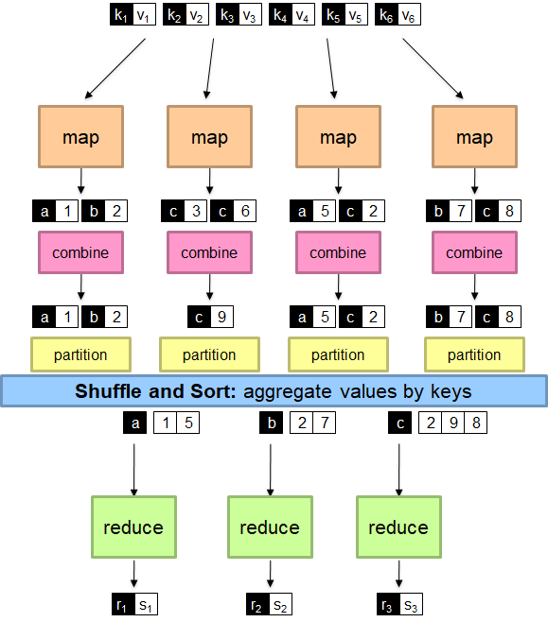
Generalized Map/Reduce
(from White, Yeh, Lin, and Davis 2010)
Notes:
Mappers process the data by assigning ids, transforming data, or translating data.
Combiners are optional optimizations
Should not affect algorithm correctness
May be run 0, 1, or multiple times
Example: find average of all integers associated with the same key
Partitioners sort like values by key to different processors
Reducers do the aggregation of values according to some criteria

Slide 25
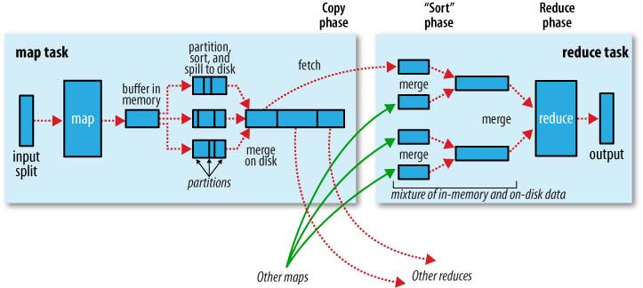
Shuffle and Sort
Notes:
Examine this diagram.
Trace the flow through the diagram.
How many times do we read and write HDFS disks in a simple MapReduce job? Class exercise!!

Slide 26
MapReduce Paradigm
A complete MapReduce job consists of code for the mapper, reducer, combiner, and partitioner, along with job configuration parameters.
Input is a set of <key, value> pairs
Mappers and Reducers are primarily used (see next pages)
Combiner
Acts like a mini-Reducer on a single machine
Condenses like keys on a single machine
Typically, only run a combiner if you are running out of memory
Partitioner
Determines what reduce task a <K,V> pair is sent to by hashing the key module the number of reducer tasks
Mappers and Reducers typically execute on the same server
Mappers and Reducers may have side effects
This allows for sharing information between iterations
The execution framework handles everything else.
Notes:
You do not have to code combiners and partitioners on your own most of the time.
Hadoop has default versions that it uses if you do not supply your own.
Why would you supply your own?
You have special criteria for combining resulting Key-value pairs from the Mapper phase.
As you produce resulting key-value pairs, you keep a count of the population per key, recognize there is a skew, and write a partitioner to balance the distribution of key-value pairs for the reducer phase.
Axiom: Obtaining satisfactory (e.g., near-optimal perfromances) requires experimentation, especially if you will be repeating these computations on subsequent data sets of the same type.

Slide 27
Mapper - I
Mapper:
The Mapper reads data in the form of key/value pairs from HDFS
It outputs zero or more key/value pairs
map(in_key, in_value) -> (inter_key, inter_value) list
The output must be in the form of key/value and is put in HDFS
Multiple Mappers run in parallel, each processing a portion of the input data
Barriers require and enforce all Mappers to complete their tasks before Reducers start.
Good for very large scale data: giga-, tera-, petabytes, but exabytes?
Write once and read many data: allows for parallelism without mutexes
Number of map tasks is configurable.
Notes:
Note: The Map function does not need to produce a resulting an output key-value pair for every input key-value pair!!
What’s an example of where this might occur?
Note: If you write your own combiners and partitioners, each of these will not start until the previous phase has been completed.
J. Leskovec, A. Rajaraman, J. Ullman: Mining of Massive Datasets, http://www.mmds.org

Slide 28
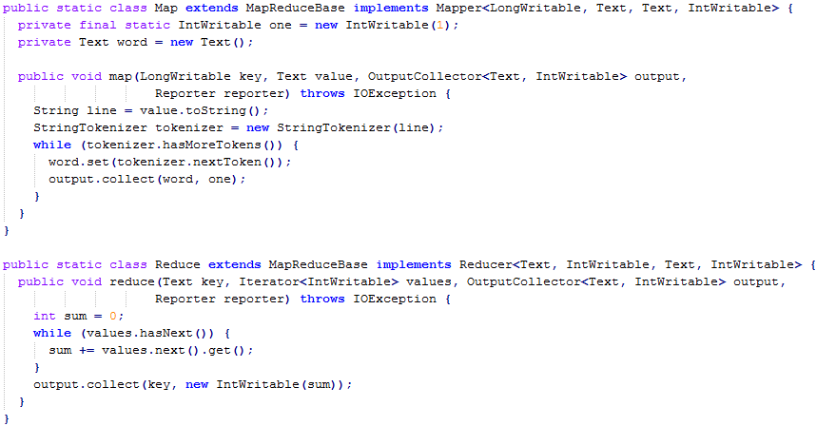
A Look at WordCount
Notes:
The Map class is the mapper and contains a method called map.
Note that it implements Hadoop classes which contain the infrastructure support. For example, reading the local HDFS instance and fetching key-value pairs.
Note that Hadoop has defined its own classes for key types and value types rather than inheriting from the basic Java types.
Map takes four arguments:
A key
Its associated value
An output variable of a given type
A Reporter class which most users do not specify
Similarly for the reducer method.
Look carefully at their definitions to understand what they do.
Rather simple code.

Slide 29
MapReduce Example: Mapping
This is a cat
Cat sits on a roof
<this 1> <is 1> <a <1,1,>> <cat <1,1>> <sits 1> <on 1> <roof 1>
The roof is a tin roof
There is a tin can on the roof
<the <1,1>> <roof <1,1,1>> <is <1,1>> <a <1,1>> <tin <1,1>> <then 1> <can 1> <on 1>
Cat kicks the can
It rolls on the roof and falls on the next roof
<cat 1> <kicks 1> <the <1,1>> <can 1> <it 1> <roll 1> <on <1,1>> <roof <1,1>> <and 1> <falls 1> <next 1>
The cat rolls too
It sits on the can
<the <1,1>> <cat 1> <rolls 1> <too 1> <it 1> <sits 1> <on 1> <cat 1>
Note: just tally occurrences in inputs to yield an integer or vector
Notes:
J. Leskovec, A. Rajaraman, J. Ullman: Mining of Massive Datasets, http://www.mmds.org

Slide 30
Reducer - I
After the Map phase is over:
All the values for a given intermediate key are combined together into a list
There may be a single Reducer, or multiple Reducers
All values associated with a particular intermediate key are guaranteed to go to the same Reducer
The intermediate keys, and their value lists, are passed to the Reducer in sorted key order
This step is known as the shuffle and sort.
Intermediate <key,value> pairs are written to HDFS
The Reducer outputs zero or more final key/value pairs
Number reduce tasks is configurable.
In practice, the Reducer usually emits a single key/value pair for each input key
There may be different output file formats
Ex: TextOutputFormat: K\tV\n
Output to files of name PART-r-00000
Where r is the number of the Reducer tasks
00000 identifies the file
Notes:
Note: The reducer may also not produce an output key-value pair for every key-value pair that it sees as input.
The combiner gathers all the data records associated with a particular key.

Slide 31
MapReduce Example: Combine & Reduce
Output from Mapper phase:
<this 1> <is 1> <a <1,1,>> <cat <1,1>> <sits 1> <on 1> <roof 1>
<the <1,1>> <roof <1,1,1>> <is <1,1>> <a <1,1>> <tin <1,1>> <then 1> <can 1> <on 1>
<cat 1> <kicks 1> <the <1,1>> <can 1> <it 1> <roll 1> <on <1,1>> <roof <1,1>> <and 1> <falls 1> <next 1>
<the <1,1>> <cat 1> <rolls 1> <too 1> <it 1> <sits 1> <on 1> <cat 1>
Combine the counts of all the same words: // use tally approach
<cat <1,1,1,1>> // so cat occurs four times in input!
<roof <1,1,1,1,1,1>> // roof occurs five times
<can <1, 1,1>>
…
Reduce (sum in this case) the counts: // sum tallies
<cat 4>
<can 3>
<roof 6>

Slide 32
Some Observations
Single-thread performance doesn’t matter
We have large data sets and total throughput/price is more important than peak performance
Stuff Breaks – need more reliability
• If you have one server, it may stay up three years (1,000 days)
If you have a cluster of 1000, probability of at least 1 server failure at any time is nearly 100%
• If you have 10,000 servers, expect to lose ten a day
“Ultra-reliable” hardware doesn’t really help
At large scales, super-fancy reliable hardware still fails, albeit less often
– software still needs to be fault-tolerant
– commodity machines without fancy hardware give better performance/price
Notes:
Database people say: but parallel databases have been doing this for decades
I am not what the upper limit on scalability is for parallel databases. Seen several claims of hundreds to thousands, but do not know If these have been verified.
Axiom: Beware of what vendors claim!!
Axiom: Verify Before Trusting!!
Map Reduce people say:
we operate at scales of 1000’s of machines
We handle failures seamlessly
We allow procedural code in map and reduce and allow data of any type

Slide 33
MapReduce: Handling Failure
With commodity servers, assume failure are common.
File replication distributes files across multiple servers, possibly in multiple racks
Replicas are typically placed on unique racks
With multiple racks, communication between racks is through switches.
Network bandwidth between machines on the same rack is greater than those in different racks.
Name Node determines the rack id for each Data Node.
Spawn multiple backup tasks
Whichever one completes first, wins!
Simple but non-optimal
Writes are expensive
Replication factor is 3
Notes:
Failure is to be expected using commodity disks.
Note that most microprocessors today are very reliable and can last for trillions of cycles.
Three common failures are: Name node failure, Data node failure and network partition.
A network partition can cause a subset of Data nodes to lose connectivity with the Name node.
Name node detects this condition by the absence of a Heartbeat message.
Name node marks Data nodes without Hearbeat and does not send any IO requests to them.
Any data registered to the failed Data node is not available to the HDFS.
Also the death of a Data node may cause replication factor of some of the blocks to fall below their specified value.

Slide 34
Handling Failure
Handled via re-execution
Detect failure via periodic heartbeats
Task completion committed through master
Robust:
Can lose thousands of machines but still complete successfully
Replicated data blocks across multiple machines
Replicated tasks across multiple machines
Probability that all machines with same data block fail is very low.
What happens if the Master Node fails?
With MR 3.0, multiple Name Nodes. one of which can take over in case of failure.
Notes:
Task trackers periodically send ‘heartbeat’ signals to job trackers.If Job Tracker does not received expected heartbeat signal from task tracker, it will declare it down.
It will try to restart it, but after <TBD> attempts will declare it dead.
Default replication factor is 3.
This was arrived at through extensive studies in fault tolerant processing back in the 1970s and 1980s.
With MR 3.0, can now handle the failure of the Master Node (e.g., the Name Node). Replicate Name Nodes execute exactly as the primary Name Node. If Primary fails, one of the secondary Name Nodes takes over and continues the job.
All secondary Name Nodes have the same information as the Primary Name Node because they are executing in lock step.

Slide 35
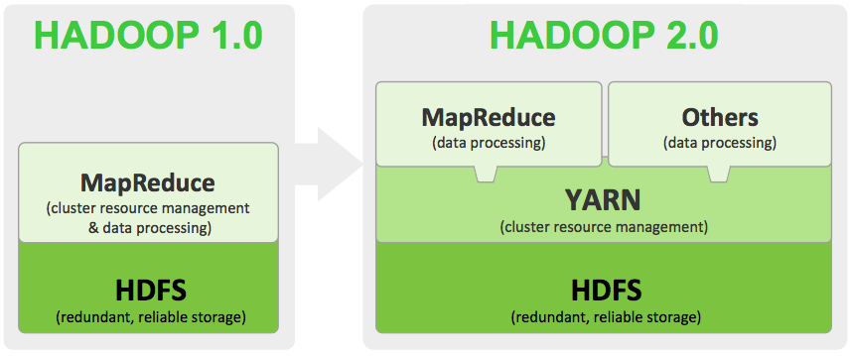
MapReduce Evolution: 1 -> 2
Java Framework ( a lot of java packages).
Promised a dramatic reduction in Cost of Operation
Separation of Concerns between data collection and analytics
May be a cost-effective alternative to a conventional (ETL) process
Suitable for unstructured data (the variety issue), distributed computing and scale.
Notes:
MapReduce has evolved over the years.
Version 1 established the basic model and infrastructure.
Version 2 separated scheduling of tasks on data nodes from the file system code.
Provided greater flexibility
Allowed MPI, which enables interaction between data nodes, to be implemented
Allowed possibility of custom parallel processing execution engines
Yet Another Resource Negotiator (YARN)
A major revolution in MR technology in Hadoop 2.x
Separated the execution engine from the resource management engine
Built-in support for multi-tenancy on cluster resources

Slide 36
MapReduce Evolution: 3
Minimum Required Java Version in Hadoop 3 is Increased from 7 to 8
YARN Version 2
V1 limited to single reader/writer – did not scale well
V2 separates reader from writers – different numbers may improve scalability
Shell scripts rewritten to improve performance:
Better error messages
Native Java Implementation for Combiners improves performance 30%
Multiple Name Nodes improves reliability
Alternatives to HDFS: Microsoft Azure Data Lake and Aliyun Object Storage System
Other fixes for the advanced user!
Source: https://www.edureka.co/blog/hadoop-3
Notes:
Well, its been several years since Version 3 was initially discussed.
I heard Doug Cutting talk about it back in 2013 or 2014 at the Hawai’i International Conference on Systems Sciences where he was a Keynote Speaker
See the edureka website and you will see some very complex changes to MapReduce which are substantial improvements, but most of which only the advanced user will understand.

Slide 37
MapReduce Issues - I
Strict synchronization between map and reduce phases:
No reduce task can start until all map tasks are complete
Slow map tasks significantly lengthen completion time.
Does not readily support asynchronous algorithms
I/O takes longer than computation
Especially in iterative algorithms; across distributed network infrastructure
Bad Input data may cause task failures requiring restart
Data skew (uneven distribution of keys) leads to performance problems
Application may have different processing for different keys
Complex algorithms need to be decomposed into cascaded or iterated MR jobs
Many problems are not (currently) mapreducible
But, they may be very amenable to MPI implementations
Notes:
37
Strict synchronization in MapReduce
In version 2, MPI allows asynchronous operation of data nodes.
Errors in processing data may cause task failures if not properly captured
Possibility of missing data in results, if ignored.
Cascading/Iterated jobs:
Allows complex applications to be created with multiple processing steps, but:
Can significantly degrade performance
Avoid object creation
Inherently costly operation
Garbage collection
Avoid buffering
Limited heap size
Works for small datasets, but won’t scale!

Slide 38
Examples of MapReducible Jobs
Benchmark for comparing: Jim Gray’s challenge on data-intensive computing. Ex: “Sort”
Google use(d,s) it for wordcount, adwords, pagerank, indexing data.
Simple algorithms such as grep, text-indexing, reverse indexing
Bayesian classification: data mining domain
Facebook uses it for various operations: demographics
Financial services use it for analytics
Astronomy: Gaussian analysis for locating extra-terrestrial objects.
Notes:
Lots of examples in the technical literature, but you need to dig deeply to see how complex the algorithms they are using are.
Axiom: Complex algorithms can substantially affect computation time.
What about Artificial Intelligence and Machine Learning?

Slide 39
MapReduce Issues - II
Determining minimum data set size given MR overhead
No cross-task communication (in MapReduce I; limited - Yarn)
Difficulty handling complex objects because of <key, value> representation
MapReduce is a low-level programming interface:
Java functions (also, C, FORTRAN, others)
Discrete control over system parameters
Higher-Level Declarative Query Languages can easy programming
Yahoo!, Pig: A relational algebra language
IBM Jaql: Similar
Acyclic data flow is inefficient for applications that repeatedly reuse a working set of data:
Iterative algorithms (machine learning, graphs)
Interactive data mining tools (R, Excel, Python)
Hadoop defines its own “box” classes for strings (Text), integers (IntWritable), etc.
Notes:
Task chunks limited to 64M bytes, but may be user selectable in future.
Note the <value> can be an object handle for a complex object:
Generally not recommended especially if inheritance involved.
Several high-level SQL-Lite query languages can be used to write code.
Since most processors implement virtual memory along with operating systems, disabling can be difficult:
You can read up on virtual memory in Wikipedia
You may learn about it in CSCI 6461: Computer Architecture
“Box” classes implement additional functionality, such as serializability, which did not work well before Java 9-10-11, but may be working correctly now.
-Note they are NOT subclasses of Integer, etc.
-So, you need to write special code to convert between them.

Slide 40
MapReduce Issues - III
Slow workers can significantly delay completion time.
Writing Map code:
Minimize # of conditionals
Minimize (or eliminate) any iterations
No recursion!
Don’t share machines with other jobs; dedicate to MapReduce
Disable processor caches; eliminate overhead
Ensure all disks have same speed and good sectors
Bad sectors cause data to transfer slowly
Report Latency very High - Takes hours to aggregate data
Raw Data processing through MapReduce still slow
Portability of code across versions is questionable (??)
Multiple vendors offer support (for a fee!!)
Axiom: TANSTAAFL: There Ain’t No Such Thing As a Free Lunch! (The Moon Is a Harsh Mistress, Robert Heinlein)
Notes:
Again, all instances of map have to complete before combiners, then partitioners, then reducers execute – in succession!
Best performance obtained if computer system dedicated to MapReduce
Yes, you can disable processor caches through the operating system.
Raw Data Processing: If the amount of raw data is very large, you may have to do lots of “data wrangling”
Best to do this as separate MR jobs
Most vendors supporting MR provided enhanced versions with additional functionality, tools, etc.
Standard MR is Apache version
Different vendors have different enhancements which makes it difficult to move between their versions.
If you must have portability, use standard MR

Slide 41
What is Spark?
Developed by UCBerkeley’s Applied Mathematics Lab to overcome deficiencies in Hadoop MapReduce
Slow due to replication, serialization, and disk IO
Inefficient for:
Iterative algorithms (Machine Learning, Graphs & Network Analysis)
Interactive Data Mining (R, Excel, Adhoc Reporting, Searching)
Provide support for interactive and iterative (streaming) computations in-memory
Resilient Distributed Dataset (RDD): fault-tolerance, in-memory storage abstraction
Scala interface, Java and Python APIs; R interface
Interactive shell: Scala, Python, R
Notes:
In-Memory computing is feasible for certain classes of computing with the large memories now available: 64-18-256-512 gigabytes,
And, with fast SSDs of 512G to several terabytes.
New Concept: Resilient Distributed Datasets support functional programming.
Read up on “functional programming” on Wikipedia
Spark is an ecosystem; Scala is a programming language.

Slide 42
Spark Ecosystem
Key Features of Spark Core:
Handles I/O Functionality
Manages Spark Cluster
Task Dispatching
Fault Recovery
Supports in-memory computation
Notes:
Spark code written in Scala
Scala compiles to JVM bytecodes.
Spark SQL: a distributed framework for structured data processing.
Spark Streaming: allows scalable, high-throughput, fault-tolerant stream processing of live data streams. Spark can access data from sources like Kafka, Flume, Kinesis or TCP socket.
Mllib: a scalable Machine learning library that makes machine learning scalable and easy.
GraphX: is a network graph analytics engine and data store. Provides clustering, classification, traversal, searching, and pathfinding algorithms.
SparkR: implements R data frames. It is a R package that gives light-weight frontend to use Apache Spark from R.

Slide 43
Spark Overview
Notes:
A user’s application program incorporates a Spark Context, which is a data structure containing parameters and status information about Spark.
The Spark Context handles:
Getting the current status of spark application
Canceling the job
Canceling the Stage
Running job synchronously
Running job asynchronously
Accessing persistent RDD
Unpersisting RDD
Programmable dynamic allocation
The Spark Shell offers command line environment with auto-completion.
A task is a unit of work that sends to the executor.
The job is parallel computation consisting of multiple tasks that get spawned in response to actions in Spark.
Spark relies on a Cluster Manager to launch executors.
Executors launch once in the beginning of Spark Application and then they run for the entire lifetime of an application.

Slide 44
Spark Cluster Manager
Apache Spark system supports three types of cluster managers
Standalone
a simple cluster manager included with Spark that makes it easy to set up a cluster.
Apache Mesos
a general cluster manager that can also run Hadoop MapReduce and service applications.
Hadoop YARN
the resource manager in Hadoop 2.
Notes:
Spark Cluster Manager:
It has masters and number of workers with configured amount of memory and CPU cores. In Spark standalone cluster mode, Spark allocates resources based on the core. By default, an application will grab all the cores in the cluster.
Apache Mesos:
Mesos handles the workload in distributed environment by dynamic resource sharing and isolation. It gathers together the existing resources of the machines/nodes in a cluster. This is the reverse of virtualization because in virtualization one physical resource divides into many virtual resources.
Hadoop YARN:
It implements a Global Resource Manager (RM) and per-application Application Master (AM).
See: https://data-flair.training/blogs/comparison-between-apache-mesos-vs-hadoop-yarn/

Slide 45
Spark and Hadoop
Spark does not replace Hadoop. Rather, it can use selected features of the Hadoop infrastructure, such as HDFS.
Standalone
YARN
Spark in MapReduce (SIMR)
Notes:
Each of these models has some complexity to it.
Spark supports two deployment modes for a standalone cluster: the cluster mode and the client mode.
-In client mode, the driver launches in the same process in which client submits the application.
-In cluster mode, the driver launches from one of worker node processes inside the cluster, the client process exits as it submits the application without waiting for the application to finish.
The other two modes require some special attention to setting variables and setting up queues.

Slide 46
Spark Limitations
NO support for real-time processing: In Spark Streaming, the arriving live stream of data is divided into batches of the pre-defined interval, and each batch of data is treated like Spark Resilient Distributed Database (RDDs).
These RDDs are processed using the operations like map, reduce, join etc. The result of these operations is returned in batches.
Small file problems (in using Hadoop): HDFS supports a limited number of large files as opposed to a large number of small files.
HDFS and Hadoop are inefficient when dealing with small files.
NO File Management System: Either relies on HDFS or a native OS file management system.
Running Spark on Windows 10 uses the Windows file management system.
Memory consumption is very high for Spark, so need lots of memory.
Spark Mllib does not have as rich a library of algorithms (though it is improving).
See this comparison with Apache Flink:
https://data-flair.training/blogs/comparison-apache-flink-vs-apache-spark/
Notes:
Every tool or technology comes with some advantages and limitations
So, the Apache Spark limitations don’t remove it from the game. It’s still in demand and industries are using it as a Big Data solution.
The latest versions of Spark are coming with continuous modifications to overcome these Apache Spark limitations.

Slide 47
Motivation-I
Benefits of data flow: runtime can decide where to run tasks and can automatically recover from failures
Acyclic data flow is a powerful abstraction, but is not efficient for applications that repeatedly reuse a working set of data:
Iterative algorithms (many in machine learning)
Interactive data mining tools (R, Python)
Spark makes working sets a first-class concept to efficiently support these apps
Retain the attractive properties of MapReduce:
Fault tolerance (for crashes & stragglers); Data locality; Scalability
Trade between result accuracy and response times
Why?
In-memory processing does not guarantee interactive query processing
e.g., ~10’s sec just to scan 512 GB RAM!
Gap between memory capacity and transfer rate increasing
Notes:
In-memory processing is much faster than disk-based processing as in MapReduce.
But, beware! Spark and Scala still can do a lot of writing to disk.

Slide 48
Scala: Why a New Language?
Two hypotheses:
Programming languages for component software should be scalable
The same concepts describe small and large parts
Rather than adding lots of primitives, focus is on abstraction, composition, and decomposition
Language that unifies object-oriented programming and functional programming can provide scalable support for components
Scala is both functional and object-oriented
every value is an object
every function is a value--including methods
Scala is statically typed
includes a local type inference system: in Java: Pair p = new Pair<Integer, String>(1, "Scala");
in Scala: val p = new MyPair(1, "scala");
Notes:
An object is a singleton object (there is only one of it)
Variables and methods in an object are somewhat similar to Java’s static variables and methods
Reference to an object’s variables and methods have the syntax ObjectName.methodOrVariableName
The name of an object should be capitalized
A class may take parameters, and may describe any number of objects
The class body is the constructor, but you can have additional constructors
With correct use of val and var, Scala provides getters and setters for class parameters

Slide 49
Scala: Functional Programming
Functions are first-class objects.
They are values, just like other objects are values, and can be treated as such
Functions can be assigned to variables
Functions can be passed as parameters to higher-order functions
Functions can be returned as results of functions
Function literals
Functions should only transform their inputs into their outputs
A function should have no side effects
It should not do any input/output
It should not change any state (any external variable)
Given the same inputs, a function should produce the same outputs, every time--it is deterministic
If a function is side-effect free and deterministic, it has referential transparency—all calls to the function could be replaced in the
program text by the result of the function
Notes:
In object-oriented programming, programmers can think of a program as a collection of interacting objects, while in functional programming (FP) a program can be thought of as a sequence of stateless function evaluations.
FP emphasizes the application of functions, in contrast to the imperative programming style, which emphasizes changes in state.
Programs written using the functional programming paradigm are much more easily representable using mathematical concepts, and thus it is much more easy to mathematically reason about functional programs than it is to reason about programs written in any other paradigm.
Q: Can all programs be representable in mathematical concepts, and therefore reasoned about mathematically?

Slide 50
Scala vs. Java
Java is a good language, and Scala is a lot like it
Not designed for highly concurrent programs, but fixed in Java 1.6
Verbose
Too much of Thing = new Thing();
Too much “boilerplate,” for example, getters and setters
Scala and Java are (almost) completely interoperable
Call Java from Scala? No problem!
Call Scala from Java? Some restrictions, but mostly OK.
Scala compiles to .class files (a lot of them!), and can be run with either the scala command or the java command
Scala has total access to the Java API
Compiles to JVM bytecodes
Almost as fast as Java (within 10%)
Hence, it can do anything Java can do, and, it can do much more
Scala:
Actions cause calculations to be performed
Transformations just set things up (lazy evaluation)
Notes:
The notion of a "function" used in imperative programming is that imperative functions can have side effects, changing the value of already calculated variables.
Because of this they lack referential transparency, i.e. the same language expression can result in different values at different times depending on the state of the executing program.
Conversely, in functional code, the output value of a function depends only on the arguments that are input to the function, so calling a function f twice with the same value for an argument x will produce the same result f(x) both times.
Eliminating side-effects can make it much easier to understand and predict the behavior of a program, which is one of the key motivations for the development of functional programming.
Axiom: Consistency of results is important in most data analysis problems!!

Slide 51
Scala: Other Features
Integration with XML
can write XML directly in Scala program
can convert XML DTD into Scala class definitions
Support for regular expression patterns
Allows defining new control structures without using macros, and while maintaining static typing
Any function can be used as an infix or postfix operator
Allows programmers to make their own control structures
Can tag the parameters of methods with the modifier def.
When method is called, the actual def parameters are not evaluated and a no-argument function is passed
Notes:
Most functional programming languages use higher-order functions, which are functions that can either take other functions as arguments or return functions as results.
The differential operator d/dx that produces the derivative of a function f is an example of this in calculus.
Higher-order functions are closely related to functions as first-class citizen, in that higher-order functions and first-class functions both allow functions as arguments and results of other functions.
The distinction between the two is subtle: "higher-order" describes a mathematical concept of functions that operate on other functions, while "first-class" is a computer science term that describes programming language entities that have no restriction on their use (thus first-class functions can appear anywhere in the program that other first-class entities like numbers can, including as arguments to other functions and as their return values).

Slide 52
Scala is Interoperable
Scala programs interoperate seamlessly with Java class libraries:
Method calls
Field accesses
Class inheritance
Interface implementation all work as in Java.
Scala programs compile to JVM bytecodes.
Scala’s syntax resembles Java’s, but there are also some differences.
object instead of static members
var: Type instead
of Type var
object Example1
{
def main(args: Array[String])
{
val b = new StringBuilder()
for (i ← 0 until args.length)
{
if (i > 0) b.append(" ")
b.append(args(i).toUpperCase)
}
Console.println(b.toString)
}
}
Scala’s version of the extended for loop (use <- as an alias for ←)
Arrays are indexed args(i) instead of args[i]

Slide 53
Scala is Concise
Scala’s syntax is lightweight and concise.
semicolon inference,
type inference,
lightweight classes,
extensible API’s,
closures as control abstractions.
Average reduction in LOC wrt Java: ≥ 2
due to concise syntax and better abstraction capabilities
var capital = Map( "US" → "Washington", "France" → "paris", "Japan" → "tokyo" )
capital += ( "Russia" → "Moscow" )
for ( (country, city) ← capital ) capital += ( country → city.capitalize )
assert ( capital("Japan") == "Tokyo" )

Slide 54
What is an RDD?
RDD stands for “Resilient Distributed Dataset”.
An RDD is an immutable collection of objects which computes on the different node of the cluster.
Resilient, i.e. fault-tolerant with the help of RDD lineage graph(DAG) and so able to recompute missing or damaged partitions due to node failures.
Distributed, since Data resides on multiple nodes.
Dataset represents records of the data you work with. The user can load the data set externally which can be either JSON file, CSV file, text file or database via JDBC with no specific data structure.
RDDs can be cached.
RDDs can be persisted.
Notes:
Keeping data in memory increases performance by an order of magnitude.
Caching is beneficial when we use RDD several times.
RDDs can be persisted in memory by default, but it can spill them to disk if there is not enough RAM.
Users can also request other persistence strategies, such as storing the RDD only on disk or replicating it across machines, through flags to persist.

Slide 55
Key Concept: RDDs
Resilient Distributed Datasets:
Collections of objects spread across a cluster, stored in RAM or on Disk
Built through bulk parallel transformations
Created by transforming data in stable storage using data flow operators (map, filter, group-by, …)
Partitioning can be based on a key in each record (using hash or range partitioning)
Can be cached across parallel operations
Automatically rebuilt on failure
Write programs in terms of operations on distributed datasets
RDDs track lineage information that can be used to efficiently recompute lost data
Notes:
A Spark Transformation is a function that produces a new RDD from the existing RDDs.
It takes RDD as input and produces one or more RDD as output.
Each time it creates a new RDD when we apply any transformation.
Thus, the input RDDs cannot be changed since RDDs are immutable in nature.
Applying transformation built an RDD lineage, with the entire parent RDDs of the final RDD(s).
This is also known as RDD operator graph or RDD dependency graph. It is a logical execution plan i.e., it is Directed Acyclic Graph (DAG) of the entire parent RDDs of RDD. Why?
Because, for fault tolerance reasons, it allows us to reconstruct an RDD in its entirety in the event of a crash or failure.

Slide 56
Lazy Evaluation
RDDs follow the principal of lazy evaluation:
Only evaluate an expression when the value is needed.
An RDD may not actually contain data, but just an expression for creating the data
When you access the RDD and ask for its data, it then evaluates the expression to produce the data
Such as caching the data or writing it out to disk
But, it might fail
Implication: you can chain a large number of computations
cachedMsgs = textFile(...).filter(_.contains(“error”))
.map(_.split(‘\t’)(2))
.cache()
HdfsRDD
path: hdfs://…
FilteredRDD
func: contains(...)
MappedRDD
func: split(…)
CachedRDD
Notes:
Transformations are lazy in nature meaning when we call some operation in RDD, it does not execute immediately.
- Spark maintains a record of which operation is being called(through a DAG).

Slide 57
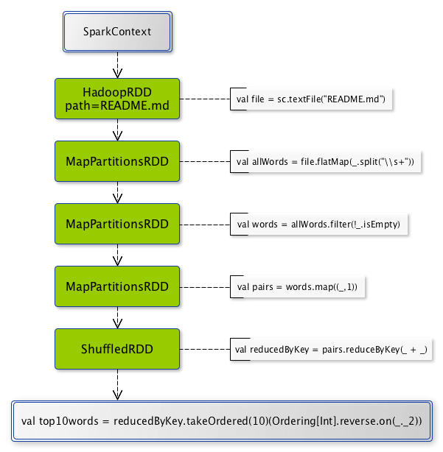
Spark RDD Transformations
Notes:
Narrow transformation – In Narrow transformation, all the elements that are required to compute the records live in parent RDD.
A limited subset is/may be used to calculate the result. Narrow transformations are the result of map(), filter().
Wide transformation – In wide transformation, all the elements that are required to compute the records may live in many partitions of parent RDD. Wide transformations are the result of groupbyKey() and reducebyKey().

Slide 58
RDD Persistence / Caching
Variety of storage levels
memory_only (default), memory_and_disk, etc…
API Calls
persist(StorageLevel)
cache() – shorthand for persist(StorageLevel.MEMORY_ONLY)
Considerations
Read from disk vs. recompute (memory_and_disk)
Total memory storage size (memory_only_ser)
Replicate to second node for faster fault recovery (memory_only_2)
Think about this option if supporting a web application
Notes:
RDDs are best suited for applications that apply the same operation to all elements of a dataset
Less suitable for applications that make asynchronous fine-grained updates to shared state
When you persist an RDD, each node stores any partitions of it that it computes in memory and reuses them in other actions on that dataset.
Cache is fault-tolerant – if any partition of an RDD is lost, it will automatically be recomputed using the transformations that originally created it

Slide 59
Spark Supports Multiple Structures
Spark now has three sets of APIs—RDDs, DataFrames, and Datasets
RDD – In Spark 1.0 release, “lower level”
DataFrames – Introduced in Spark 1.3 release
Dataset – Introduced in Spark 1.6 release
DataFrame:
Unlike an RDD, data organized into named columns, e.g. a table in a relational database.
Imposes a structure onto a distributed collection of data, allowing higher-level abstraction
Dataset:
Extension of DataFrame API which provides type-safe, object-oriented programming interface (compile-time error detection)
Notes:
Python & R don’t have compile-time type safety checks, so only support DataFrame
Error detection only at runtime
Java & Scala support compile-time type safety checks, so support both DataSet and DataFrame
Dataset APIs are all expressed as lambda functions and JVM typed objects
any mismatch of typed-parameters will be detected at compile time.

Slide 60
Traits
Similar to interfaces in Java, but can’t contain state
They may have implementations of methods
Supports multiple inheritance (which Java does not)
trait Similarity
{
def isSimilar(x: Any): Boolean;
def isNotSimilar(x: Any): Boolean = !isSimilar(x);
}
class Point(xc: Int, yc: Int) with Similarity
{
var x: Int = xc;
var y: Int = yc;
def isSimilar(obj: Any) =
obj.isInstanceOf[Point] &&
obj.asInstanceOf[Point].x == x;
}

Slide 61
Mixin Classes
Basic inheritance model is single inheritance
But mixin classes allow more flexibility
class Point2D(xc: Int, yc: Int)
{
val x = xc;
val y = yc;
// methods for manipulating Point2Ds
}
class ColoredPoint2D(u: Int, v: Int, c: String)
extends Point2D(u, v)
{
var color = c;
def setColor(newCol: String): Unit = color = newCol;
}

Slide 62
Mixin Classes
Point2D
ColoredPoint2D
Point3D
ColoredPoint3D
ColoredPoint2D
class Point3D(xc: Int, yc: Int, zc: Int)
extends Point2D(xc, yc)
{
val z = zc;
// code for manipulating Point3Ds
}
class ColoredPoint3D(xc: Int, yc: Int, zc: Int, col: String)
extends Point3D(xc, yc, zc)
with ColoredPoint2D(xc, yc, col);

Slide 63
Spark: Example
sc.textFile(“/wiki/pagecounts”)
.map(line => line.split(“\t”))
.map(R => (R[0], int(R[1])))
.reduceByKey(_+_, 3)
.collect()
RDD[String]
RDD[List[String]]
RDD[(String, Int)]
RDD[(String, Int)]
Array[(String, Int)]
collect
map
reduceByKey
textFile
map
Stage 1
Stage 2

Slide 64
Supported File Formats
Spark makes it simple to load and save data in multiple file formats:
Text files Plain old text files – one record per line
JSON Common text-based format, semistructured,
CSV Comma-separated values, often used with spreadsheets
SequenceFiles a Hadoop format for key/value data
Protocol buffers a fast, space-efficient Multilanguage format
Object files Basically serialized Java classes, but prone to breakage if you change your classes

Slide 65
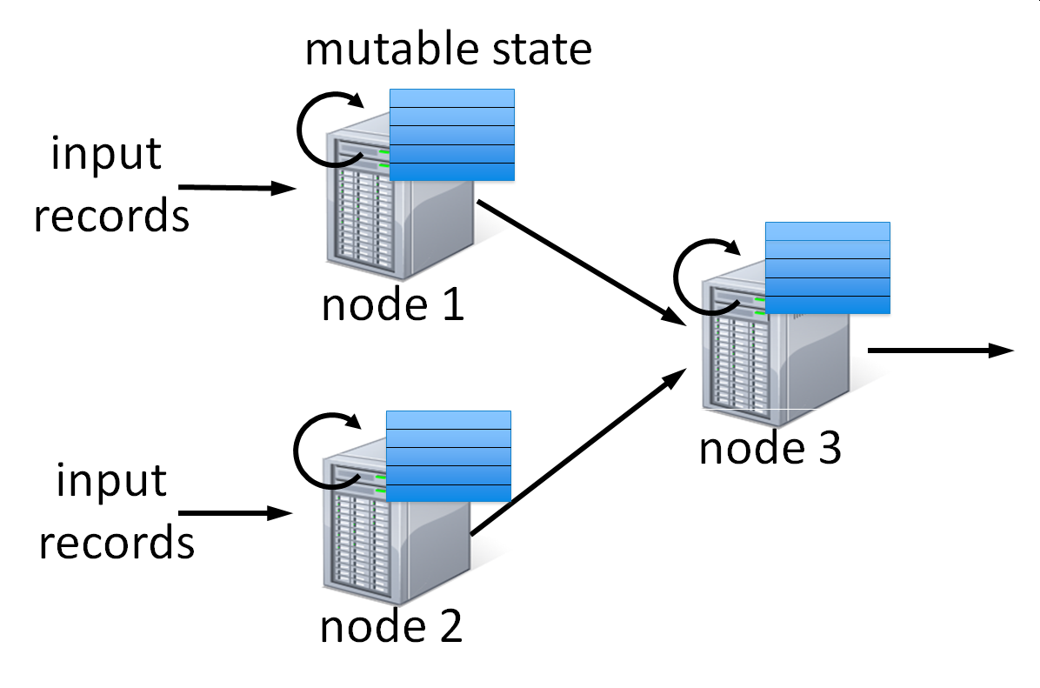
Spark Streaming - I
Many important applications must process large streams of live data and provide results in near-real-time
Traditional streaming systems have a event-driven record-at-a-time processing model
Each node has mutable state
For each record, update state & send new records
State is lost if node dies!
Making stateful stream processing be fault-tolerant is challenging

Slide 66
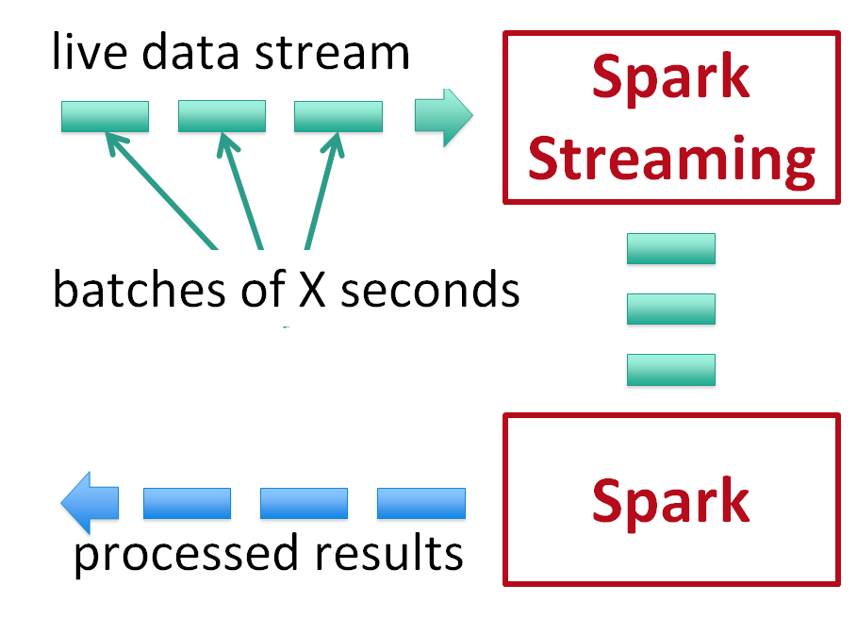
Spark Streaming - II
Run a streaming computation as a series of very small, deterministic batch jobs
Batch sizes as low as ½ second, latency ~ 1 second
Potential for combining batch processing and streaming processing in the same system

Slide 67
Spark vs. MapReduce
Performance: Spark normally faster but with caveats
Spark can process data in-memory; Hadoop MapReduce persists back to the disk after a map or reduce action
Spark generally outperforms MapReduce, but it often needs lots of memory to do well; if there are other resource-demanding services or can’t fit in memory, Spark degrades
MapReduce easily runs alongside other services with minor performance differences, & works well with the 1-pass jobs it was designed for
Ease of use: Spark is easier to program
Data processing: Spark more general
Maturity: Spark maturing, Hadoop MapReduce mature
“Spark vs. Hadoop MapReduce” by Saggi Neumann (November 24, 2014)
https://www.xplenty.com/blog/2014/11/apache-spark-vs-hadoop-mapreduce/

Slide 68

Scala In Depth

Slide 69
Choose the Right Tool for the Task
Solving human problems using limited resources is engineering
Necessarily involves trade-offs
Trade-off decisions should be made wisely
Cargo cult engineering is unwise
Some Big Data Considerations:
Prematurely designing systems “for scale” is just another instance of premature optimization…
We do not need a distributed file system, Postgres will do. …
We do not need a distributed compute cluster; a horizontally sharded compute system will do.
Do not choose a technology because it’s the “newest/latest thing” (fad-based engineering) or “this will scale far beyond my needs” (overengineering)

Slide 70
References
Dean, J. and S. Ghemawat. 2008. MapReduce: simplified data processing on large clusters. Communications of ACM 51(1):107-113
See Technical Books on Blackboard
“MapReduce” White paper, written by Jeffrey Dean and Sanjay Ghemawat, google researchers in 2004 - http://static.googleusercontent.com/media/research.google.com/en/us/archive/mapreduce-osdi04.pdf
“BigTable” White paper, written by google researchers in 2006 - http://static.googleusercontent.com/media/research.google.com/en/us/archive/bigtable-osdi06.pdf
Apache Foundation took Yahoo’s version of MapReduce, now found at: http://hadoop.apache.org
See the books in Technical Books on Blackboard

Slide 71
Additional Material

Slide 72
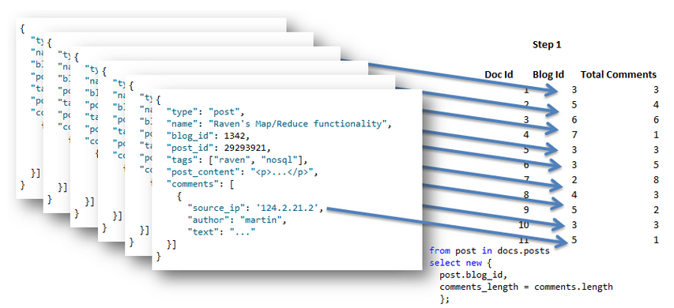
Another Example - III
Apply the map query to the set of documents that we have, producing this output:
Oren Eini, https://ayende.com/blog/4435/map-reduce-a-visual-explanation

Slide 73
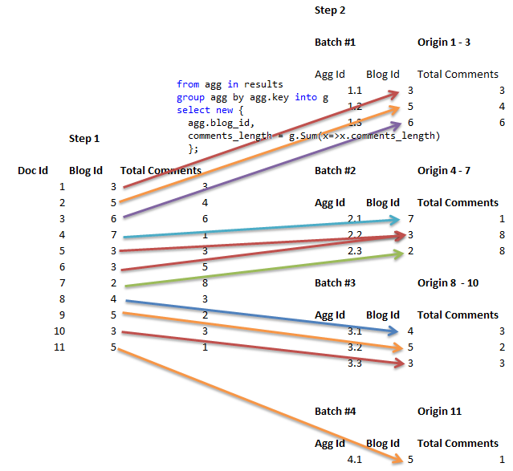
Another Example - IV
Reduce the results
Assume the output of the first step was divided into groups of 3 (so 4 groups overall)
for every batch,
we apply a sum by
blog_id to get a
new Total Comments value
Oren Eini, https://ayende.com/blog/4435/map-reduce-a-visual-explanation

Slide 74
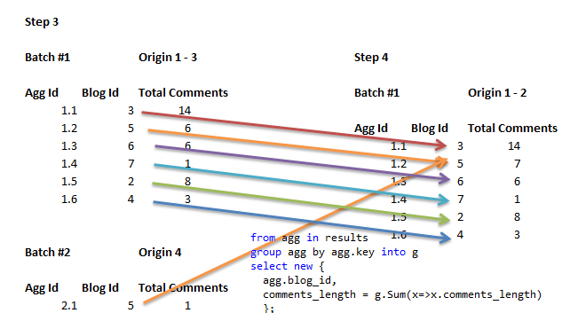
Another Example - V
Reduce the data further still
The input & output format of the reduce query must match, we will feed the output of several the reduce queries as the input of a new one
All keys
are now
unique
Oren Eini, https://ayende.com/blog/4435/map-reduce-a-visual-explanation

Slide 75
MapReduce Jobs: Driver Code
// Configure your MapReduce job in the main() method of your
// driver code
public class WordCountDriver
{
public static void main(String args[]) throws Exception
{
Job = new Job(new Configuration, “app name”);
job.setJarByClass(WordCountDriver.class);
//set the input and output formats
TextInputFormat.setinputPath (job, new Path (arg[0]));
TextOutputFormat.setoutputPath (job, new Path((arg[1]));
job.setMapperClass(WordMapper.class);
job.setReducerClass(SumReducer.class);
job.setCombinerClass(SumReducer.class);
job.setInputFormatClass(TextInputFormat.class);
job.setOutputFormatClass(TextOutputFormat.class);
Job.setOutputKeyClass(Text.class);
Job.setOutputValueClass(IntWritable.class);
System.exit(job.waitForCompletion(True)?0:1);
}
}

Slide 76
Another Example - I
Suppose we have a set of documents of the form:
{
"type": "post",
"name": "Raven's Map/Reduce functionality",
"blog_id": 1342,
"post_id": 29293921,
"tags": ["raven", "nosql"],
"post_content": "<p>...</p>",
"comments":
[
{
"source_ip": '124.2.21.2',
"author": "martin",
"text": "..."
}]
}
We want to query over the set of documents
Oren Eini, https://ayende.com/blog/4435/map-reduce-a-visual-explanation

Slide 77
Another Example - II
We can use the map reduce code:
from post in docs.posts
select new
{
post.blog_id,
comments_length = comments.length
};
from agg in results
group agg by agg.key into g
select new
{
agg.blog_id,
comments_length = g.Sum(x=>x.comments_length)
};
Note:
The first query is the map query, it maps the input document into the final format.
The second query is the reduce query, it operates over a set of results and produces an answer.
Oren Eini, https://ayende.com/blog/4435/map-reduce-a-visual-explanation

Slide 78
MapReduce Issues - IV
Scalability:
Dimensions: Performance? Cost? Effort?
Resources: Computing, Memory, Mass Storage, Interconnects, People, Budgets
Algorithms:
Don’t forget them!
O(1): constant time in n, the number of input items to process
O(n log n): decent, and probably the best we can do in most cases
O(n²), O(n³), …: polynomial time, generally slow, but still useful
O(2^{n}), …: exponential time, often common for AI tasks
Axiom: A system not designed to scale is hard to transform --- but doable with a lot of effort
Axiom: Changes in scale affect everything!

Slide 79
Scala is Precise
All code on the previous slide
used library abstractions, not
special syntax.
Advantage: Libraries are
extensible and give fine-
grained control.
Elaborate static type system
catches many errors early.
Specify map implementation: HashMap Specify map type: String to String
import scala.collection.mutable._
val capital = new HashMap[String, String] with SynchronizedMap[String, String]
{ override def default(key: String) = "?" }
capital += ( "US" → "Washington", "France" → "Paris", "Japan" → "Tokyo" )
assert( capital("Russia") == "?" )
Mixin trait SynchronizedMap to make capital map thread-safe
Provide a default value: "?"

Slide 80
Scala: Creating Lists
scala> List('a', 'b', 'c')
res0: List[Char] = List(a, b, c)
scala> "abc" toList
res1: List[Char] = List(a, b, c)
scala> "Welcome to Scala" split(" ")
res2: Array[java.lang.String] = Array(Welcome, to, Scala)
scala> val scala = "Scala" toList
scala: List[Char] = List(S, c, a, l, a)
scala> "Hello" :: scala
res3: List[Any] = List(Hello, S, c, a, l, a)

Slide 81
Scala: Nil and ::
scala> List()
res4: List[Nothing] = List()
scala> Nil
res5: scala.collection.immutable.Nil.type = List()
scala> List() == Nil
res6: Boolean = true
scala> List[String]()
res7: List[String] = List()
scala> "xyz" :: Nil “::” is the append operator
res8: List[java.lang.String] = List(xyz)
scala> "abc" :: "xyz" :: Nil
res9: List[java.lang.String] = List(abc, xyz)

Slide 82
Scala: head, tail and isEmpty
scala> val penn = "Pennsylvania" toList
penn: List[Char] = List(P, e, n, n, s, y, l, v, a, n, i, a)
scala> penn head
res10: Char = P
scala> penn tail
res11: List[Char] = List(e, n, n, s, y, l, v, a, n, i, a)
scala> penn isEmpty
res12: Boolean = false
scala> Nil isEmpty
res13: Boolean = true
scala> Nil head
java.util.NoSuchElementException: head of empty list (plus many more lines!)

Slide 83
Scala: take, drop and splitAt
scala> penn
res16: List[Char] = List(P, e, n, n, s, y, l, v, a, n, i, a)
scala> penn take 4
res17: List[Char] = List(P, e, n, n)
scala> penn drop 4
res18: List[Char] = List(s, y, l, v, a, n, i, a)
scala> penn splitAt 4
res19: (List[Char], List[Char]) = (List(P, e, n, n),List(s, y, l, v, a, n, i, a))
scala> penn.splitAt(4)
res20: (List[Char], List[Char]) = (List(P, e, n, n),List(s, y, l, v, a, n, i, a))

Slide 84
Scala: toString and mkString
scala> List(1, 2, 3).toString
res25: String = List(1, 2, 3)
scala> List(1, 2, 3).toString == "List(1, 2, 3)"
res26: Boolean = true
scala> List(1, 2, 3) mkString(" is less than ")
res27: String = 1 is less than 2 is less than 3
scala> List(1, 2, 3) mkString("*")
res28: String = 1*2*3
scala> List(1, 2, 3) mkString("<: ", "--", " :>")
res29: String = <: 1--2--3 :>
scala> List(1, 2, 3) mkString("(", ", ", ")")
res30: String = (1, 2, 3)

Slide 85
Scala: zip and unzip
scala> val words = "one two three" split " "
words: Array[java.lang.String] = Array(one, two, three)
scala> val numbers = List(1, 2, 3, 4, 5)
numbers: List[Int] = List(1, 2, 3, 4, 5)
scala> val z = words zip numbers
z: Array[(java.lang.String, Int)] = Array((one,1), (two,2), (three,3))
scala> val zz = numbers zip words
zz: List[(Int, java.lang.String)] = List((1,one), (2,two), (3,three))
scala> z toMap
res31: scala.collection.immutable.Map[java.lang.String,Int] = Map((one,1), (two,2), (three,3))
scala> zz unzip
res32: (List[Int], List[java.lang.String]) = (List(1, 2, 3),List(one, two, three))

Slide 86
Scala: Functions
The basic syntax of a function literal is: parameter_list => function_body
A higher-order function is one that takes a function as a parameter, or returns a function as a result
scala> val brag = "Scala is great!" toList
brag: List[Char] = List(S, c, a, l, a, , i, s, , g, r, e, a, t, !)
scala> brag count((ch: Char) => ch == 'a')
res34: Int = 3
scala> brag count((ch: Char) => !(ch isLetter)) e.g., space, space, !
res35: Int = 3
scala> "Scala is great!".toList.count((ch: Char) => ch < 'f')
res36: Int = 9
scala> "aeiou" contains 'e'
res37: Boolean = true
scala> "Scala is great!".toList.count((ch: Char) => "aeiou" contains ch)
res38: Int = 5

Slide 87
Scala: forAll and exists
Whereas count returns an Int, forall and exists return a Boolean
scala> val n = List(3, 1, 4, 1, 6)
n: List[Int] = List(3, 1, 4, 1, 6)
scala> n forall(x => x < 8)
res53: Boolean = true
scala> n forall(x => x < 5)
res54: Boolean = false
scala> n exists(_ < 5)
res55: Boolean = true
scala> n exists(_ > 8)
res56: Boolean = false

Slide 88
Scala: forEach
foreach returns the unit value
scala> val brag = List("Scala", "is", "great!") brag: List[java.lang.String] = List(Scala, is, great!)
scala> brag foreach (println(_))
Scala is great!
scala> brag foreach(println)
Scala is great!
scala> List(3, 1, 4, 1, 6) foreach (x => if (x > 1) println(x))
3 4 6
Notice how we called println

Slide 89
Scala: Map
map produces a new list by applying the given function to each element of the given list
scala> val n = List(1, 2, 3, 4, 5)
n: List[Int] = List(1, 2, 3, 4, 5)
scala> n map(x => x * x)
res65: List[Int] = List(1, 4, 9, 16, 25)
scala> n map (_ >= 3)
res66: List[Boolean] = List(false, false, true, true, true)

Slide 90
Scala: flatMap
flatMap produces a new list by applying the given function to each element of the given list, and “flattening” the result
scala> n
res70: List[Int] = List(1, 2, 3, 4, 5)
scala> n map (x => List(x, x*x))
res72: List[List[Int]] = List(List(1, 1), List(2, 4), List(3, 9), List(4, 16), List(5, 25))
scala> n flatMap(x => List(x, x*x))
res73: List[Int] = List(1, 1, 2, 4, 3, 9, 4, 16, 5, 25)

Slide 91
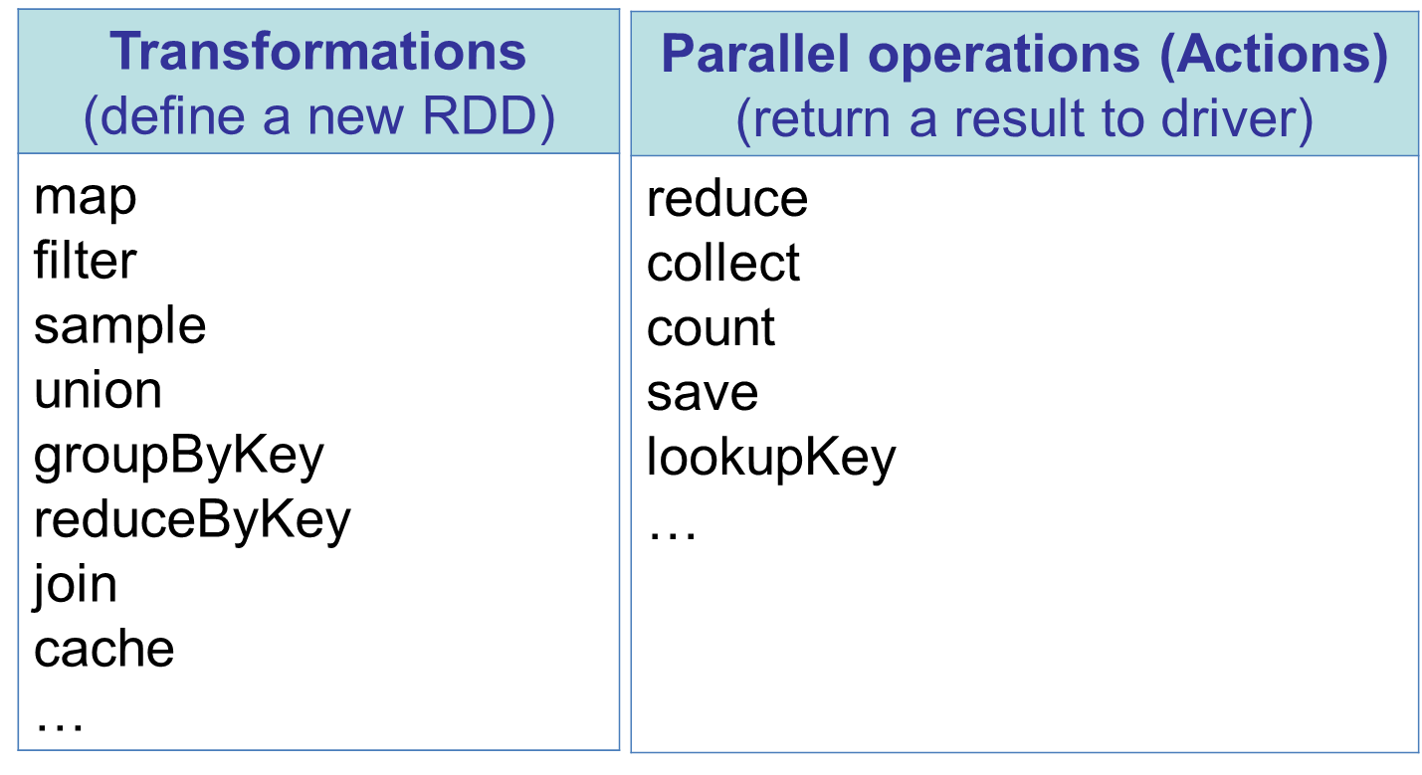
RDD Operations

Slide 92
Transformations
Transformations create a new data set from an existing one:
All transformations are lazy:
Do not compute the transformations right away
Remember them applied to some base data set
Why?
Optimize the required calculations
Recover from lost data partitions
Functional programming!!

Slide 93
Some Basic Transformations
nums = sc.parallelize([1, 2, 3])
# Pass each element through a function
squares = nums.map(lambda x: x*x) // {1, 4, 9}
# Keep elements passing a predicate
even = squares.filter(lambda x: x % 2 == 0) // {4}
# Map each element to zero or more others
nums.flatMap(lambda x: => range(x))
# => {0, 0, 1, 0, 1, 2}

Slide 94
Some Basic Actions
nums = sc.parallelize([1, 2, 3])
# Retrieve RDD contents as a local collection
nums.collect() # => [1, 2, 3]
# Return first K elements
nums.take(2) # => [1, 2]
# Count number of elements
nums.count() # => 3
# Merge elements with an associative function
nums.reduce(lambda x, y: x + y) # => 6
# Write elements to a text file
nums.saveAsTextFile(“hdfs://file.txt”)

Slide 95
Working w/ Key-Value Pairs
Spark’s “distributed reduce” transformations operate on RDDs of key-value pairs
Python: pair = (a, b) pair[0] # => a pair[1] # => b
Scala: val pair = (a, b) pair._1 // => a pair._2 // => b
Java: Tuple2 pair = new Tuple2(a, b); pair._1 // => a pair._2 // => b

Slide 96
Some Key-Value Operations
pets = sc.parallelize( [(“cat”, 1), (“dog”, 1), (“cat”, 2)])
pets.reduceByKey(lambda x, y: x + y) # => {(cat, 3), (dog, 1)}
pets.groupByKey() # => {(cat, [1, 2]), (dog, [1])}
pets.sortByKey() # => {(cat, 1), (cat, 2), (dog, 1)}
reduceByKey also automatically implements combiners on the map side

Slide 97
Another Example of Key-Value Operations
visits = sc.parallelize([ (“index.html”, “1.2.3.4”), (“about.html”, “3.4.5.6”), (“index.html”, “1.3.3.1”) ])
pageNames = sc.parallelize([ (“index.html”, “Home”), (“about.html”, “About”) ])
visits.join(pageNames) # (“index.html”, (“1.2.3.4”, “Home”)) # (“index.html”, (“1.3.3.1”, “Home”)) # (“about.html”, (“3.4.5.6”, “About”))
visits.cogroup(pageNames) # (“index.html”, ([“1.2.3.4”, “1.3.3.1”], [“Home”])) # (“about.html”, ([“3.4.5.6”], [“About”]))

Slide 98
Programming Language Support
Python
lines = sc.textFile(...) lines.filter(lambda s: “ERROR” in s).count()
Scala
val lines = sc.textFile(...) lines.filter(x => x.contains(“ERROR”)).count()
Java
JavaRDD<String> lines = sc.textFile(...); lines.filter(new Function<String, Boolean>()
{ Boolean call(String s)
{ return s.contains(“error”); } }).count();

